Slide 1
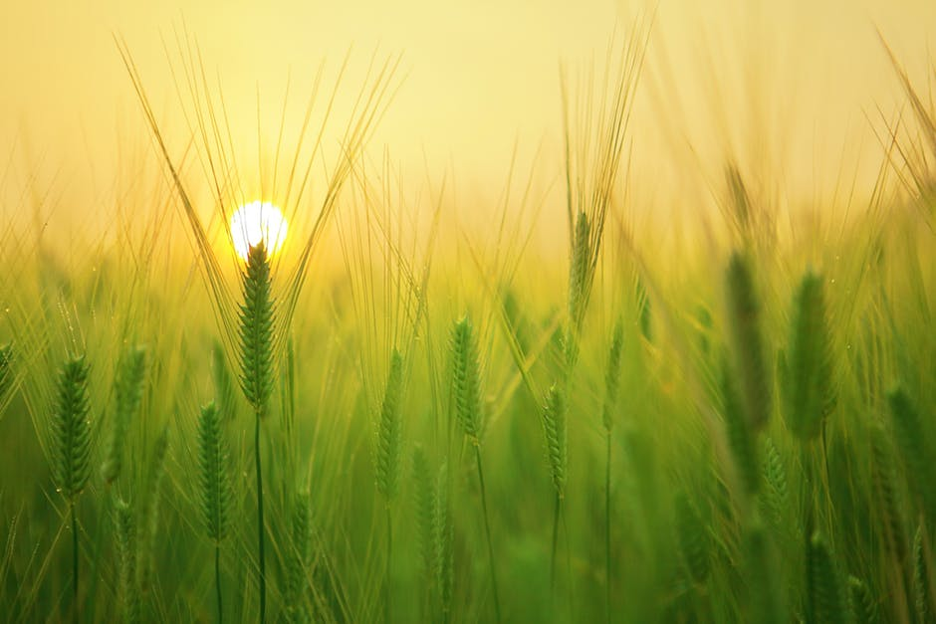
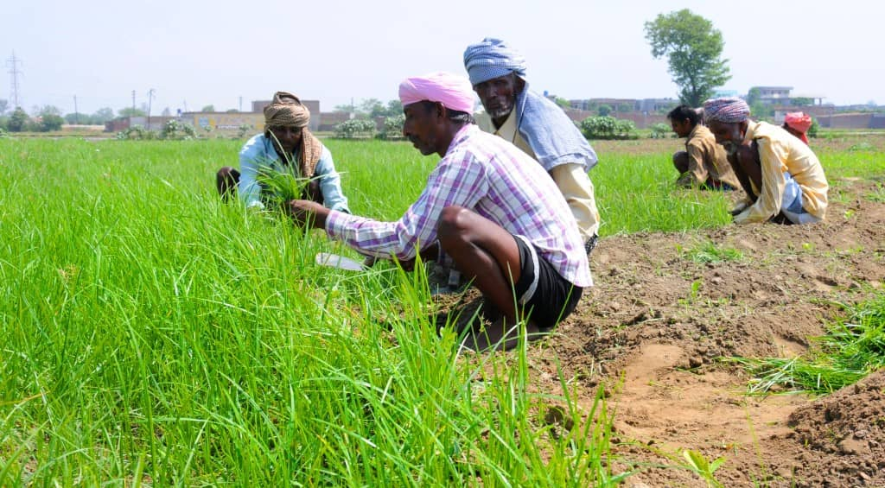
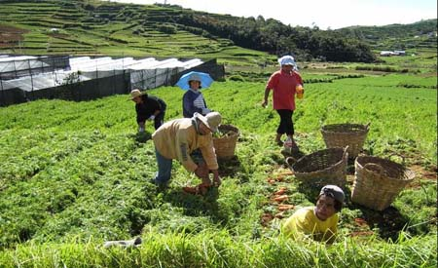
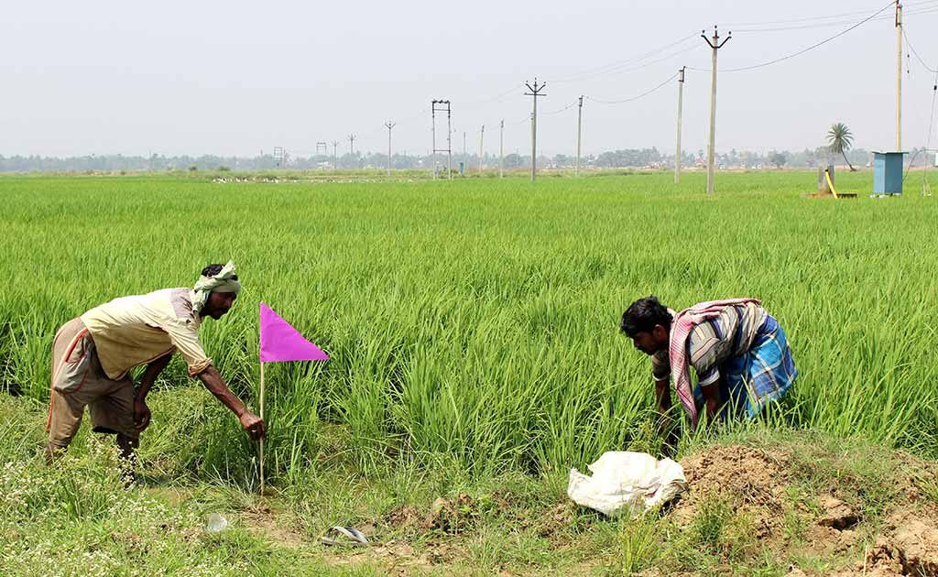
Farmers and problems
Indian farmers are in distress. The generally poor economics of the agriculture sector, crop failures, non-remunerative prices for crops and poor returns over cost of cultivation have led them into a vicious cycle of never-ending debt. Between 1995 and 2013, 296,438 farmers committed suicide in the country.

Slide 2

PROBLEMS
Large number of people engaged in agriculture(263 millions)
0.5 million call centers for 263 millions
23 different languages
Insufficient knowledge of farmers about advanced seeds, market prices, weather forecast, weeds, pesticides etc.
Large numbers of call results in unanswered queries
Many farmers commit suicide because of above reasons
Huge amount spent on running call centers.

Slide 3

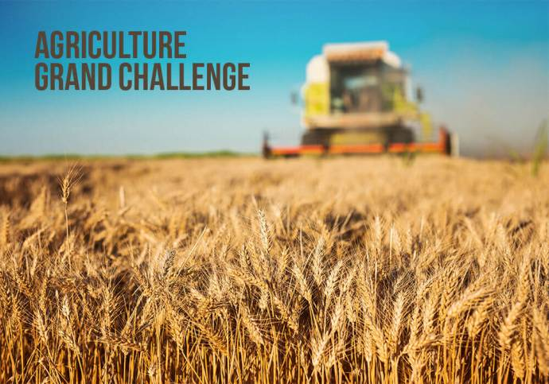
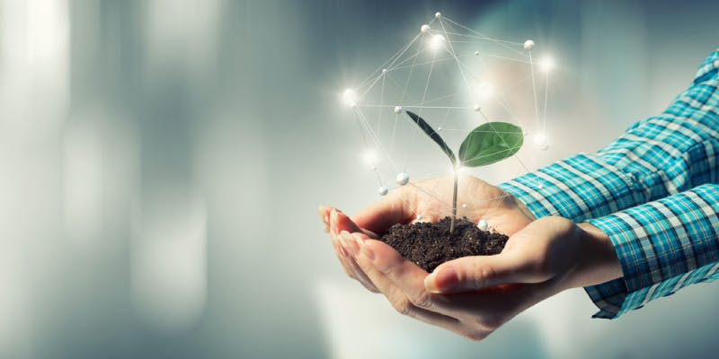
Farmers and technology
21st century offers so much technology then why should farmers be left behind? In India, according to a recent study, 11 crore farmers are on the internet and use internet (mobile internet) for various things like social media, weather forecast, seeds revolution etc. Indian Agriculture Department have set up 5 lakh call centers across India. The biggest hurdle to all this is the absence of technological resources and education. To make a farmer understand the working of big labor machines and tech-devices we need to educate them first. Smart farming (SF) involves the incorporation of information and communication technologies.

Slide 4
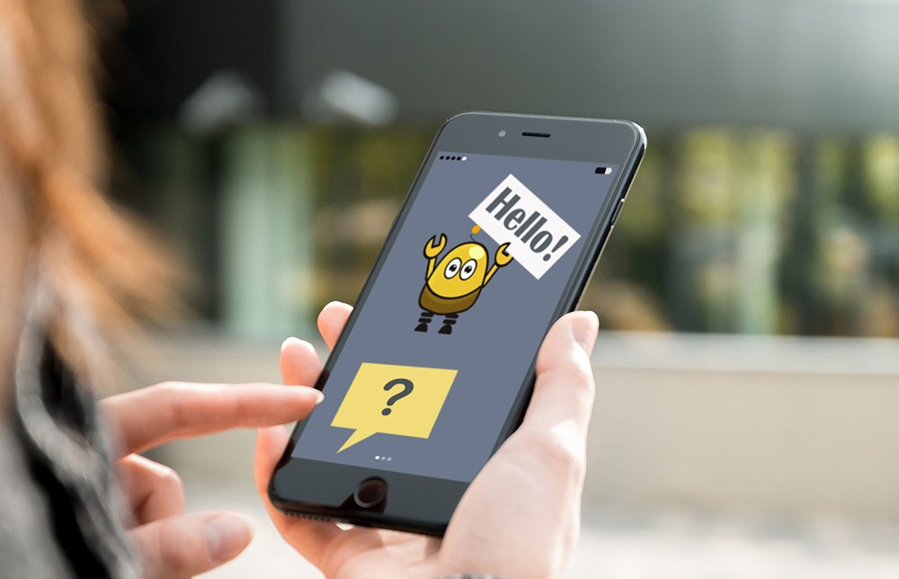
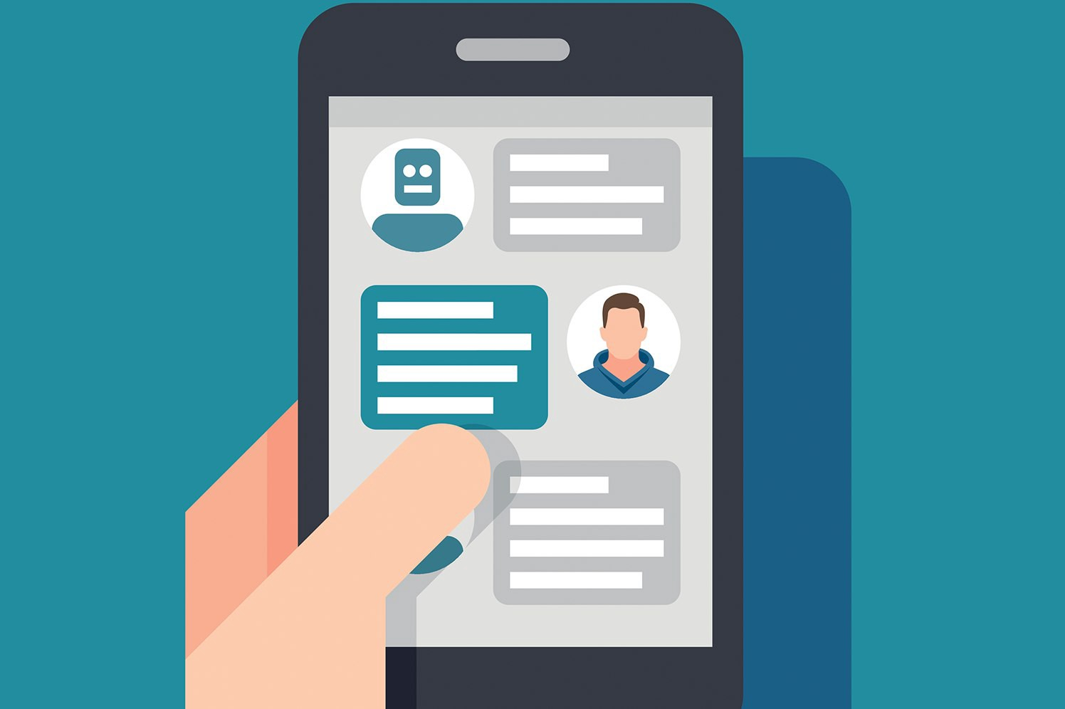
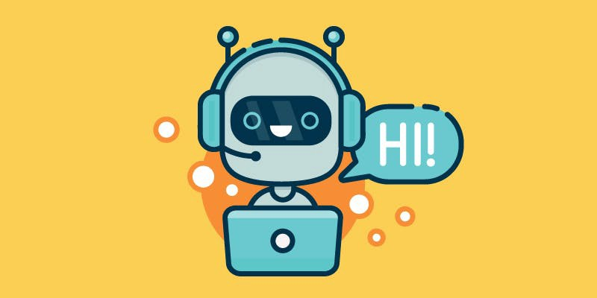
What we are going to develop
we are going to develop a smart voice assistant(chatbot) that is able to understand the local language of the farmer and answer the queries in his/her local language itself. The voice assistant is intelligent enough to support multiple Indic languages and make the conversation look more like human interaction through neural networks and machine learning. We are going to empower every farmer of India with the assistant by which they can get their queries solved easily. they won't need to call anyone not call centers nor offices to get their queries solved. This will save a lots of capital.

Slide 5




What does farmer get?
Farmer
1
2
3
4
Smart assistant
Understands local language
Gets the queries solved
Personal assistant

Slide 6
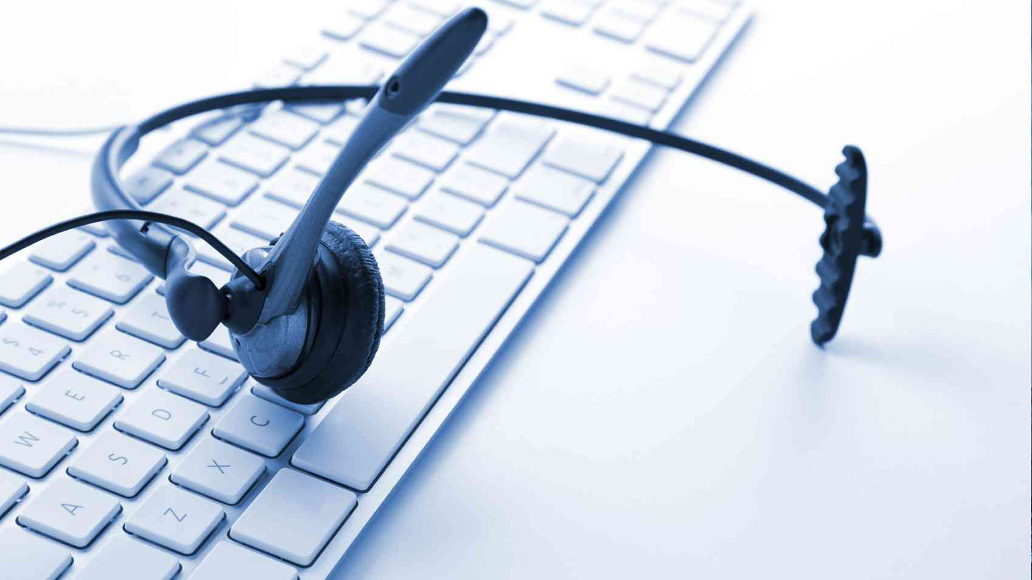
There are only 0.5 million call centers for 263 millions.
Our voice assistant would be more than ever skilled and equipped not just for script reading but for more complex problems. They need to be able to act autonomously should a problem arise.
Large numbers of call results in unanswered queries that’s why the assistant is going to be a middleware. The voice assistant is going to answer all the queries and if it won’t be able to answer then the call is transferred to call centers. No huge amount of money will be spent of call centers.

Slide 7
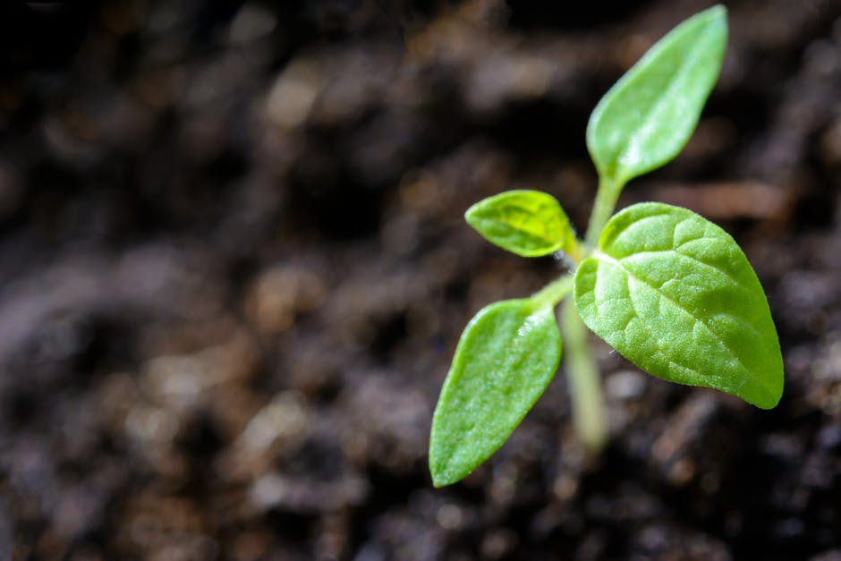
Insufficient knowledge of farmers about advanced seeds, market prices, weather forecast, weeds, pesticides etc. they are going to be answered in no time because the assistant is trained for the questions.

Slide 8
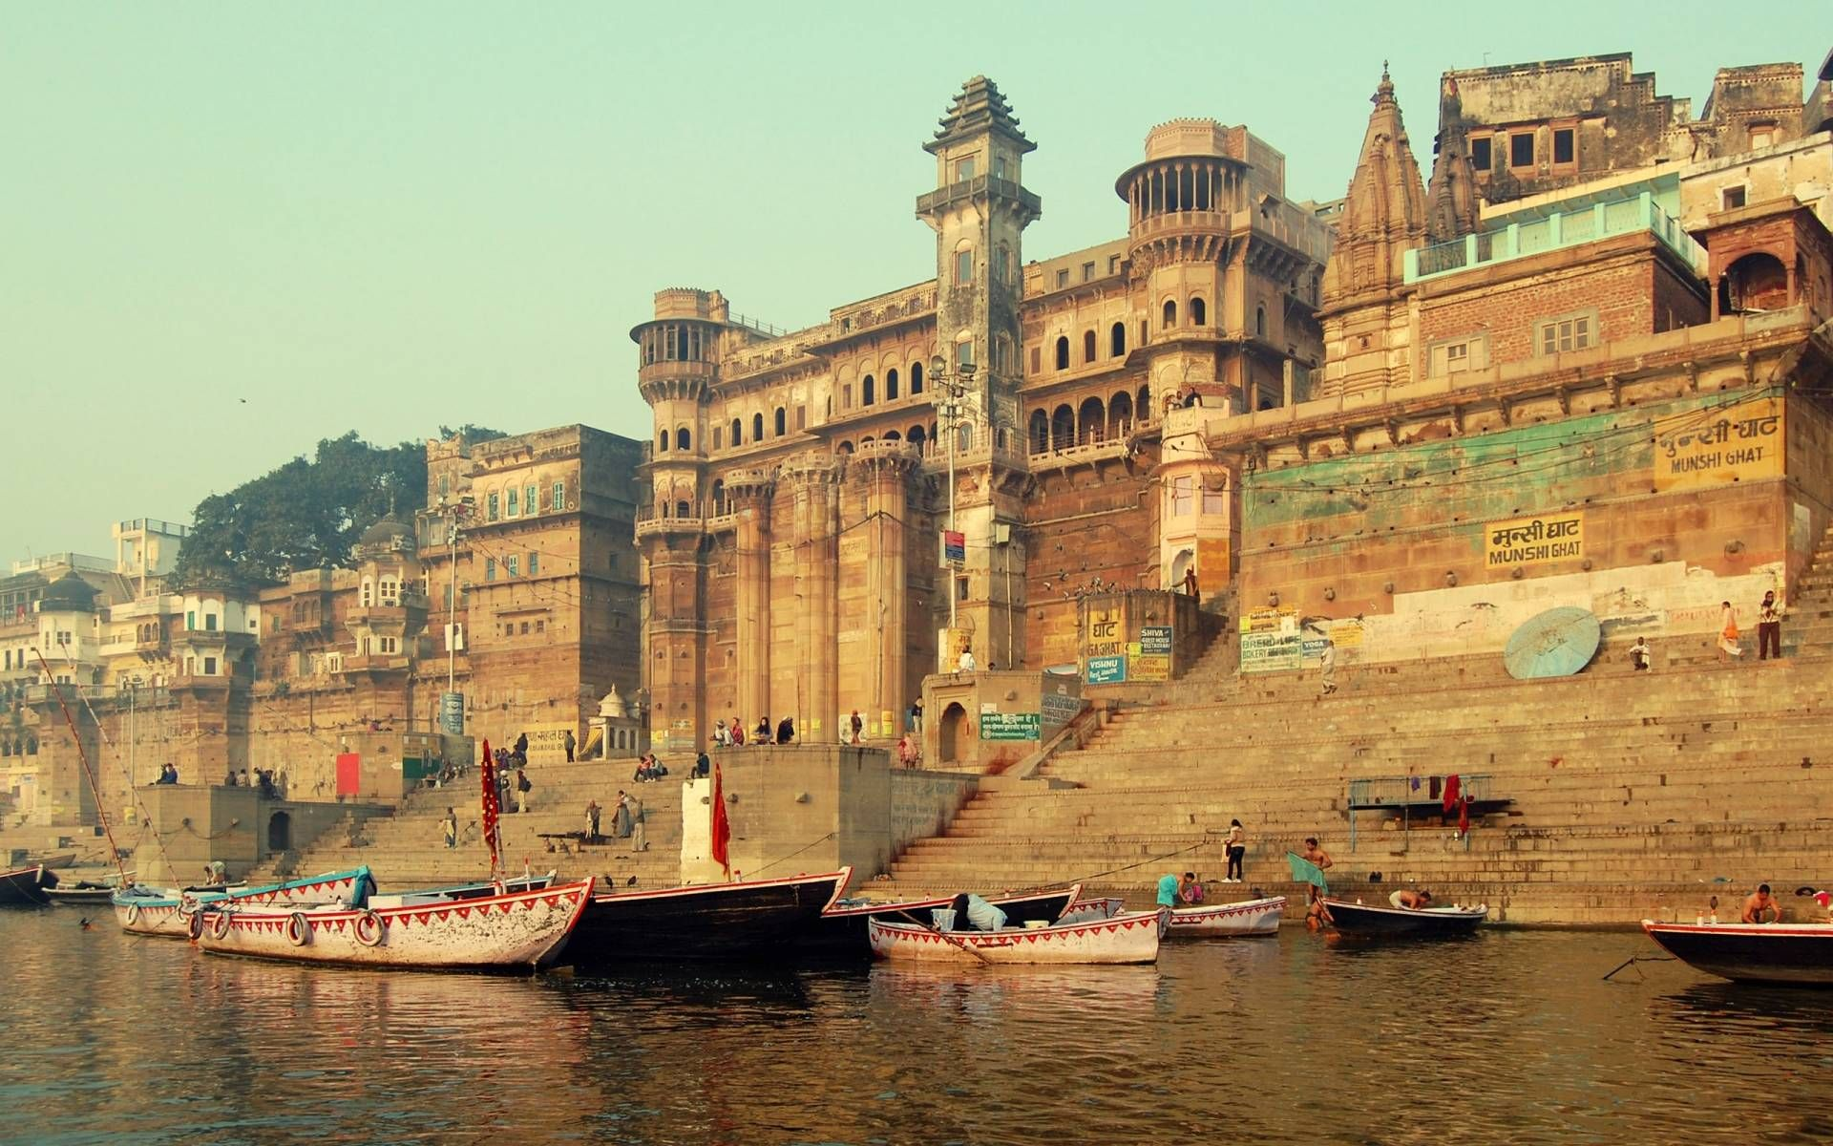
There are 23 different languages in India and all of the languages are going to be converted into English and then answered so there would be no clustering of different data.

Slide 9
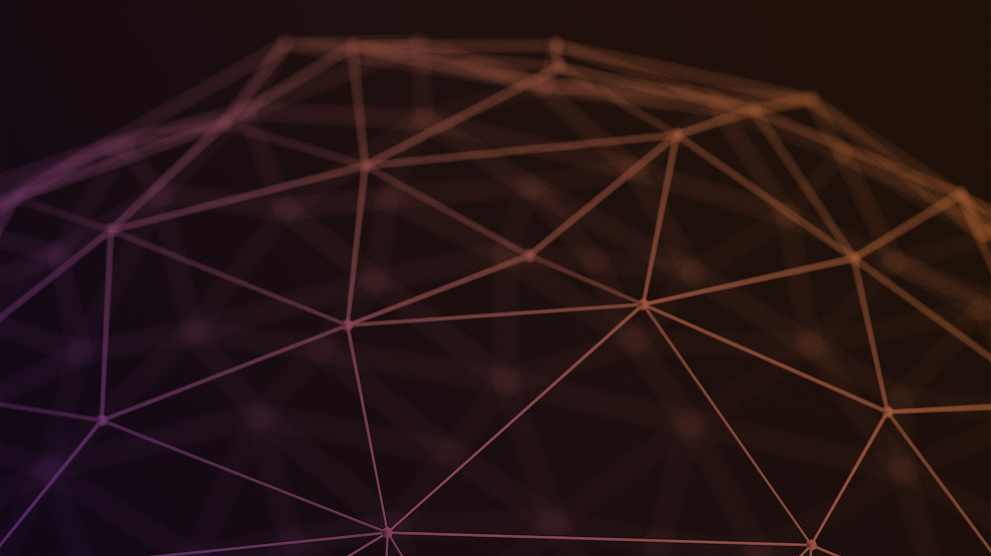
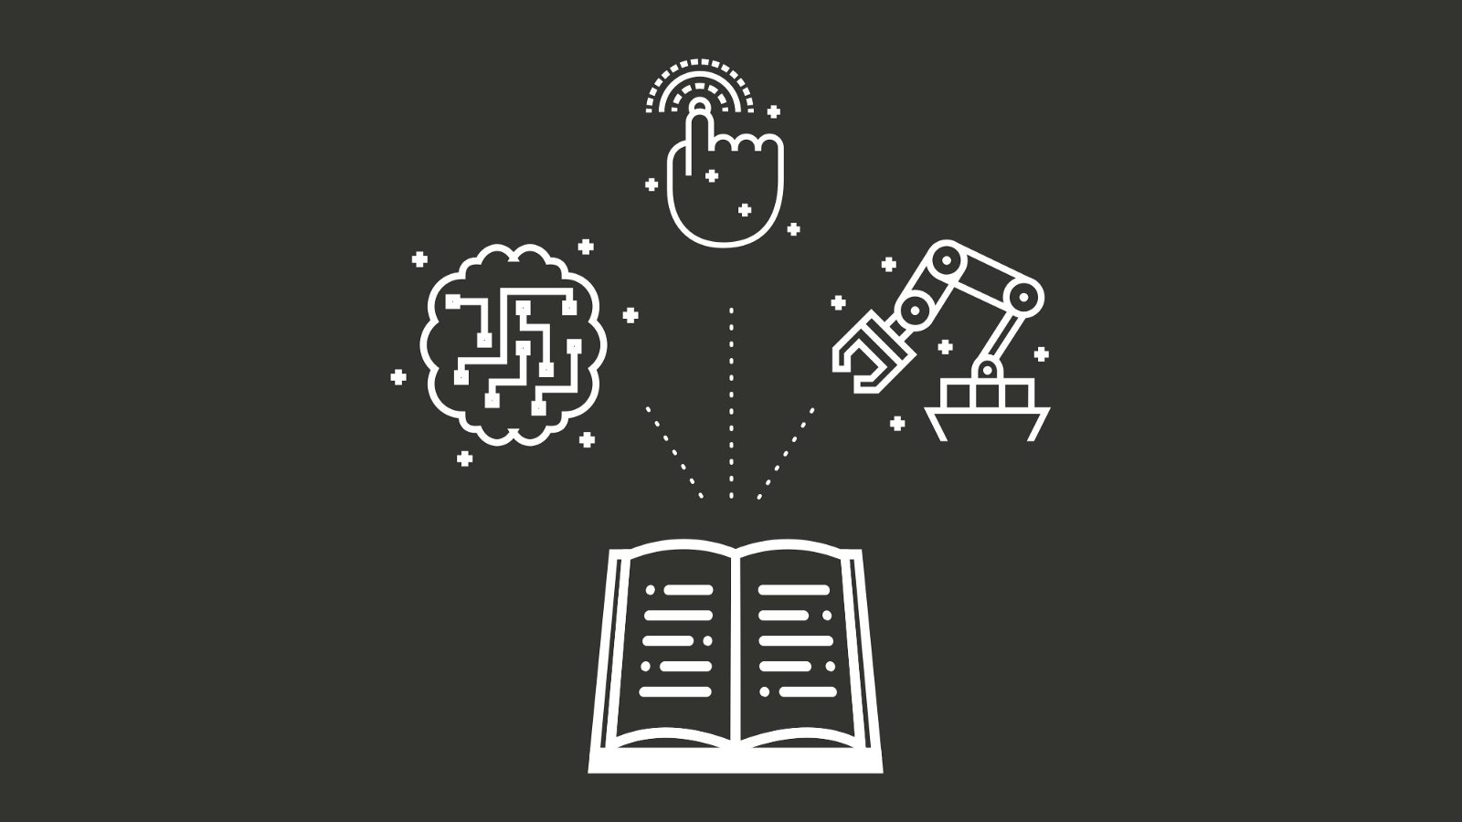
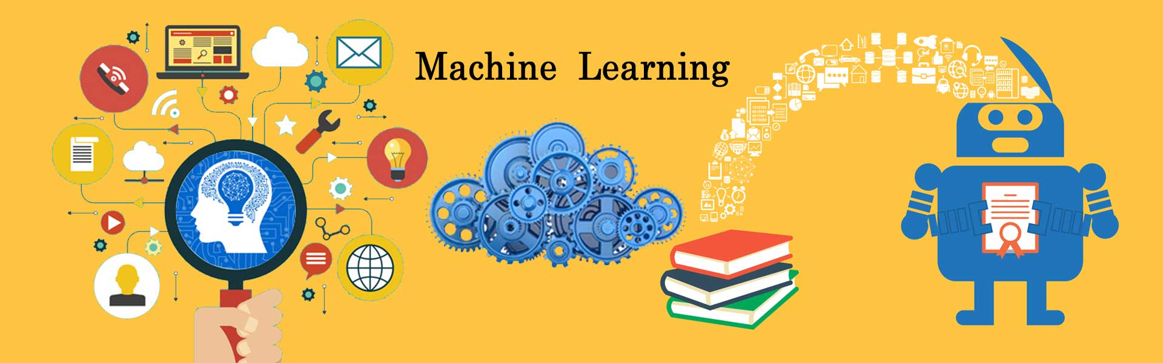
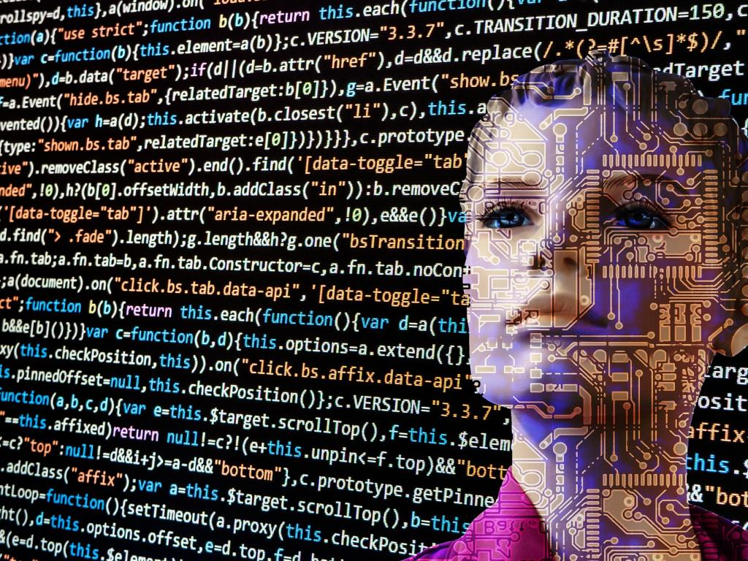
The machine is going to be trained in such a way that it will record all the calls(user & call center) and train itself from different conversations.
All the conversations can be stored if you want to do some analysis on it.

Slide 10
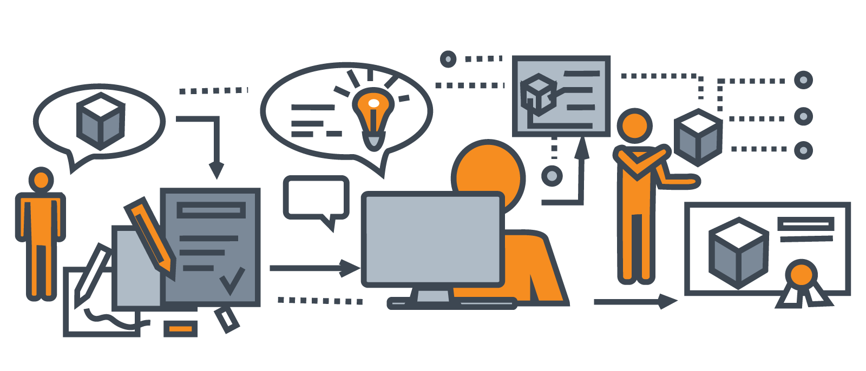
Business Model
Infrastructure– Only computers are needed no other expenses.
Finances – this is the part of the business that determines its financial performance and profit. So the core idea is that computers are going to answer the people so the expenditures in call centers will reduce exponentially.

Slide 11



Supporting #Digital India
You get alerts
aims towards the promotion of digital literacy and creation of digital infrastructure for empowering rural communities. Considering that 58% of rural households depend on agriculture as one of their most eminent source of livelihood, the role of Digital Agriculture needs to be considered within Digital India.
This is where it gets meaty. imagine you could use your this app to receive a notification when it is going to rain, if new better fertilizers are there, new technology is there and everything on this app.

Slide 12
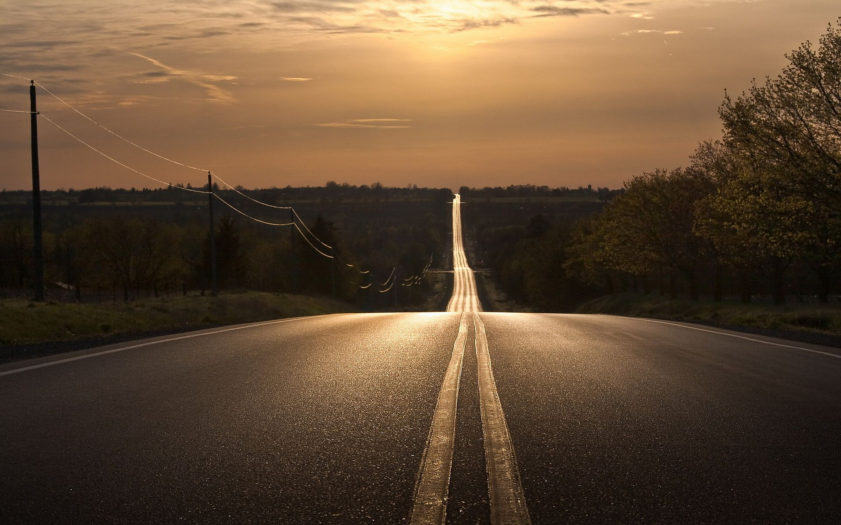
Future additions
You can send images of crop to know the problems , if it is damaged or not.
Suicide helpline for the farmers.

Slide 13
